Slide 1
Compiler Phases Explained Through a Familiar Analogy
Real-Time Example: ATM Cash Withdrawal
CSA1402-Compiler design
Presented by:
M.Madhu Rushwika(192371066)
Course Faculty: Dr N.Deepa

Slide 2

Real-Time Example: ATM Cash Withdrawal
Compiler Phases Explained Through a Familiar Analogy
A compiler processes your program just like an ATM processes your transaction — through distinct, sequential phases. Each phase has a specific role, and the output of one becomes the input to the next.
Source Code
Lexical Analysis
Syntax Analysis
Semantic Analysis
.

Slide 3
Scenario: User Request (Source Code)
You want to withdraw ₹5,000 from an ATM. This everyday transaction mirrors exactly what happens when a programmer writes source code — a human-readable instruction that must be processed, validated, and executed by a machine.
ATM Input Sequence
Compiler Equivalent
01
The programmer writes a single line of source code that encapsulates the entire request:
Insert ATM Card
Identify the user to the system
withdraw(5000);
02
This source code, like the ATM input, must pass through multiple phases before any action is taken. The compiler — like the ATM — does not execute blindly. It validates, transforms, and optimizes before producing a result.
Enter PIN
Authenticate the user's identity
03
Select "Withdraw Cash"
Specify the operation to perform
04
Enter ₹5,000
Provide the operand/value

Slide 4

Phase 1 – Lexical Analysis (Tokenization)
The first phase of compilation — and the ATM's first action — is to break the input into its smallest meaningful units, called tokens. The lexical analyzer (or scanner) reads the source code character by character and groups them into recognized symbols.
ATM Checks Individual Inputs
ATM Input vs. Compiler Token Equivalent
Card Inserted ✔
ATM Input
Compiler Equivalent
The ATM recognizes a valid card as an identifier
Card
Identifier
PIN Entered ✔
PIN
Number
A numeric value — treated as a number token
Withdraw
Keyword
Withdraw Option Selected ✔
₹5000
Constant
A reserved operation — treated as a keyword
These are treated as separate "tokens." The lexical analyzer does not check meaning or order — it only identifies and classifies each unit of input.
Amount Entered ✔
₹5,000 — treated as a numeric constant

Slide 5


Phase 2 – Syntax Analysis
Once tokens are identified, the syntax analyzer (parser) checks whether they appear in the correct grammatical order. This is analogous to the ATM verifying that operations are performed in the right sequence — you cannot enter an amount before inserting your card.
✔ Correct Sequence
❌ Wrong Sequence → Error
1
Enter Amount First
Then Insert Card
Insert Card
Attempting to enter ₹5,000 before inserting the card
❌ Error: Invalid operation — sequence violated
2
Compiler: Checks grammar rules (e.g., missing semicolons, unmatched brackets). ATM: Checks the order of operations. Both reject input that violates the expected structure.
Enter PIN
3
Choose Withdraw
4
Enter Amount

Slide 6




Phase 3 – Semantic Analysis
Syntax being correct does not mean the request is meaningful. The semantic analyzer checks whether the program makes logical sense — just as the ATM verifies whether the transaction is actually valid beyond the correct sequence of steps.
ATM Semantic Checks
Validation Examples
Scenario
Balance
Requested
Result
Valid Transaction
₹20,000
₹5,000
✔ Approved
PIN Correct?
Insufficient Funds
₹3,000
₹5,000
❌ "Insufficient Balance"
Similarly, the compiler checks: Are variables declared before use? Are data types compatible? Is a function called with the correct number of arguments? Semantic errors are logically wrong even when syntactically correct.
Account Active?
Sufficient Balance?
Limit Exceeded?

Slide 7

Phase 4 – Intermediate Code Generation
After validation, both the ATM and the compiler prepare an internal representation of the task — a platform-independent set of instructions that bridges the gap between the high-level request and the final machine-level execution.
ATM Internal Steps
Compiler Equivalent (Intermediate Code)
1
Verify Account
The compiler generates a simplified, abstract instruction set:
Confirm identity and account status internally
t1 = checkBalance()
approve = true
2
Check Balance
Query the account balance from the banking system
This intermediate code is not yet machine code — it is a structured, language-independent representation that can later be optimized and translated. It makes the compiler portable across different hardware architectures.
3
Reserve ₹5,000
Place a hold on the funds before dispensing
Intermediate code is like the ATM's internal transaction record — not the final action, but the prepared blueprint for it.

Slide 8

Phase 5 – Optimization
The code optimizer improves the intermediate code by eliminating redundant operations, reducing execution time, and minimizing resource usage — without changing the program's output. The ATM analogy makes this intuitive: why check the balance twice when once is sufficient?
Without Optimization
With Optimization
Step 1: Check Balance
Step 2: Check Balance Again
Check Balance Once
Single query — result is reused wherever needed
Query account balance from the banking server
Redundant query — same result, wasted time and resources
This saves time — just like compiler optimization removes redundant or unnecessary instructions. Common optimization techniques include constant folding, dead code elimination, and loop unrolling. The ATM equivalent is eliminating duplicate server calls during a single transaction.

Slide 9



Phase 6 – Code Generation
The final phase translates the optimized intermediate code into machine code — actual instructions the hardware can execute. For the ATM, this is the moment of truth: cash is dispensed, the account is updated, and a receipt is printed.
ATM Final Actions
Compiler Equivalent
Dispense ₹5,000
Generate Machine Code
Execute Program
Physical cash is released from the ATM vault
The CPU runs the machine code — the program performs its intended function
Translate optimized intermediate code into binary instructions specific to the target processor architecture
Update Account Balance
The bank's system deducts ₹5,000 from the account
Print Receipt
Code generation is the culmination of all prior phases. Every validation, transformation, and optimization feeds into this final output — just as every ATM check leads to the dispensing of cash.
Transaction record is generated for the user

Slide 10
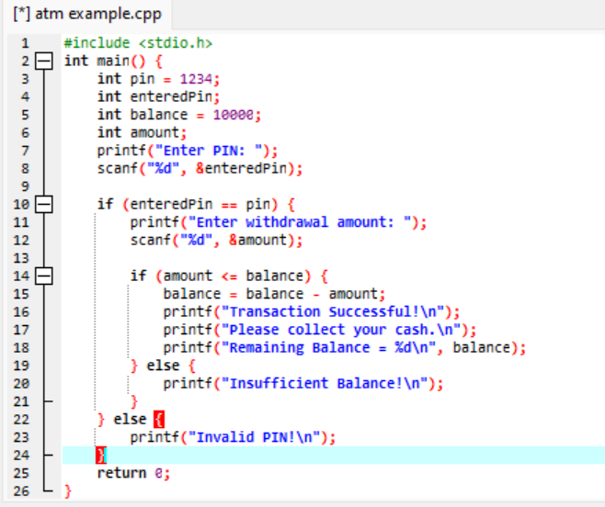
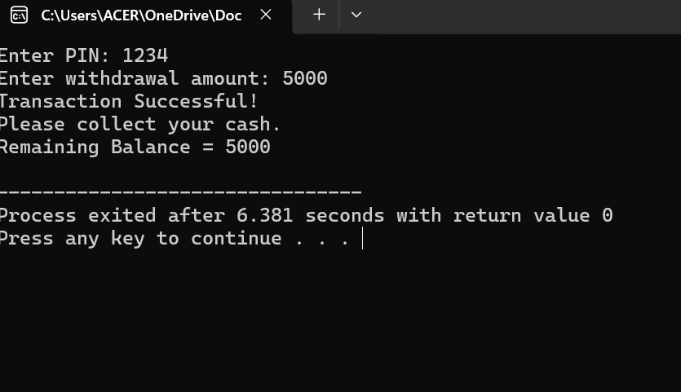

Slide 11








Complete Flow: ATM → Compiler Phases
The full pipeline — from user request to final output — mirrors the compiler's phase-by-phase architecture. Each stage is dependent on the successful completion of the previous one.
User Request
Lexical Analysis
Source code / ATM input
Recognize inputs as tokens
Syntax Analysis
Semantic Analysis
Check correct order
Check validity and meaning
Intermediate Processing
Optimization
Code Generation
Prepare internal instructions
Remove extra/redundant steps
Dispense cash / execute program
The output of one phase becomes the input to the next — a clean, sequential pipeline with no phase skipped.

Slide 12
Conclusion
Just as a compiler converts a program into machine code through several phases, an ATM processes a user's request step by step before dispensing cash. The analogy is not merely illustrative — it is structurally accurate at every stage.
Phase-Specific Tasks
Sequential Pipeline
Accuracy & Security
Each phase performs a specific task — no phase does the work of another
The output of one phase becomes the input to the next — a strict, ordered flow
This ensures the transaction — or program — is both accurate and secure

